Slide 1


Pentegra 3(16) Fiduciary Overlay Services
An independent fiduciary solution for your plan administration

Slide 2

It’s About Your Peace Of Mind
Pentegra’s 3(16) Fiduciary Overlay Services raises the oversight of the administration of your plan to an even higher level.
You have the assurance that every administrative detail is carefully reviewed by one of America’s oldest professional fiduciaries.
A 3(16) Fiduciary is a person or company responsible for a retirement plan’s administrative duties.

Slide 3

The 3(16) Administrative Fiduciary
An Extra Set of Eyes on the Plan
As a 3(16) administrative fiduciary, we are an extra set of eyes on your plan. We take care of the overall operation and the administrative tasks associated with your plan.
Relieve the administrative responsibilities of your team
Reduce your risk of liability
Improve plan outcomes
Spend more time on other areas of your business

Slide 4
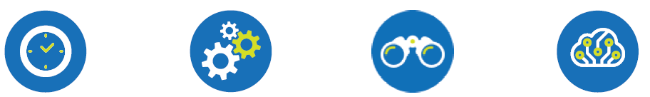
It’s About Your Peace Of Mind
Administrative Relief
Save time and reduce the responsibilities of ongoing maintenance and annual filings for your retirement plan.
Seamless Integration
Our services are layered on to your existing relationships with record keepers without disruption.
Optimal Plan Oversight
Continual proactive
monitoring by experts
in 3(16) fiduciary
administration who
work seamlessly with
your team.
Advanced Technology
An online vault monitored by AI ensures safe storage
of documents for ongoing, accurate monitoring.

Slide 5
With our extensive experience as a fiduciary, Pentegra can identify issues that often elude others.
We’ve saved clients hundreds of thousands of dollars in fines and penalties.
Outsource Your Stress Points
Pentegra’s 3(16) Fiduciary Overlay Services work in conjunction with your recordkeeper. As your 3(16) fiduciary, Pentegra provides the monitoring requirements specified under ERISA.
As an independent fiduciary, we review and monitor your plan to ensure its success.

Slide 6


Minimize the Risk, Responsibility and Time Required to Run a Retirement Plan
Fiduciary Warranty – our promise to you. We stand behind our work.
Plan design review and recommendations – to ensure your retirement plan is effective and successful, with optimum uptake by employees.
Annual government filings – we complete, sign and submit all annual forms including Form 5500.
Legislative updates – we ensure your plan complies with current legislation and requirements.
Day-to-day administrative functions – we review compliance testing, review plan distributions and conduct regular due diligence reviews and proactively monitor the plan on an ongoing basis.
Plan audit oversight – we work with the external auditors and your team to resolve plan issues and deal directly with the IRS and DOL on your behalf.
Annual and quarterly meetings – for scheduled monitoring and check-ins.

Slide 7
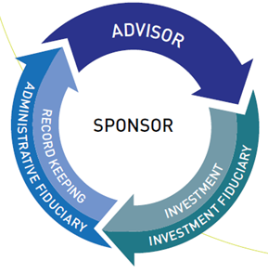
A Seamless Solution
Existing Relationships Stay Intact
Pentegra’s 3(16) Fiduciary Overlay Services are layered onto your current relationship with a recordkeeper and 3(38) Plan Advisor. We call this approach an overlay, because all existing trusted relationships stay intact, without any disruptions. Our services are simply added on – or overlaid – seamlessly.

Slide 8

What Happens When You Outsource To Pentegra?
Optimal Plan Oversight
Continual proactive monitoring by experts in 3(16) fiduciary administration.
Dedicated Account Manager
Responsive, personalized service from your Consultant and Account Manager.
Customized Suite of Services
A full suite of standard services, with à la carte options for a tailored solution.

Slide 9

A Long History As A Trusted Fiduciary
Pentegra is part of an elite group of TPA firms in the U.S. that have successfully completed the independent certification process offered by The Centre for Fiduciary Excellence, LLC (CEFEX).
Pentegra is one of America’s oldest, most experienced independent institutional fiduciaries. In fact, we were built to be a fiduciary.

Slide 10
A Long History As A Trusted Fiduciary
1943 We were founded 80 years ago as a Named Plan fiduciary — long before the role formally existed under ERISA. | Fiduciary First We are committed to a higher standard of care than many other companies, for an unmatched level of expertise and oversight.
Independent We always put your best interests first because there is never any conflict of interest. Administering your retirement plan is our priority. | 40,000 complex retirement plans with 1 million participants — and growing!

Slide 11
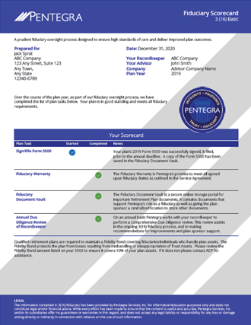
Pentegra’s Commitment To Innovation
As a fiduciary, Pentegra is committed to excellence and constant innovation. We develop systems and technologies that support our high standards of care and facilitate greater plan governance and oversight.

Slide 12

What Happens When You Outsource To Pentegra?
Pentegra Ecosystem
Our secure cloud-based vault safely stores plan documents in a
centralized location and facilitates ongoing monitoring so key plan tasks are always completed and tracked.
Artificial Intelligence
AI proactively identifies potential issues such as discrepancies or missing information before they become problems and escalates them to a team member.
Fiduciary Scorecard
Our annual Fiduciary Scorecard summarizes plan fiduciary
responsibilities and their status for full transparency and optimal oversight.

Slide 13

The Peace of Mind of a Professional on Board
Deep expertise from dedicated professionals
The Pentegra team includes highly trained retirement plan experts committed to exceptional plan outcomes.
Our bench includes in-house ERISA attorneys and ASPPA-certified QPA, QKA and CPC Account Managers.

Slide 14

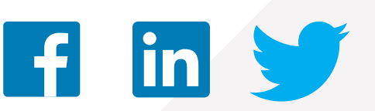
Contact Us
Let’s talk about how Pentegra can help you
Contact a Pentegra representative today
Pentegra Retirement Services
855-549-6689
www.pentegra.com
http://316fiduciaryday.com/

