Slide 1


Pentegra Consulting Services
Build Plan Compliance Confidence

Slide 2






The Pentegra Difference
A Fiduciary First
Eight Decades of Expertise
An Independent Perspective
As a 402(a) Named Fiduciary, we hold ourselves to the highest standard of ERISA, for a higher level of care.
An 80+ year legacy serving as
an institutional ﬁduciary delivers an unmatched level of expertise.
As an independent ﬁduciary, we bring complete objectivity and impartiality to our work, resulting in greater plan governance and oversight.
A Higher Level of Responsibility
CEFEX Certiﬁed for a Higher
Standard of Care
Compliance Conﬁdence
As a ﬁduciary, we provide expert oversight and in-depth knowledge, shouldering much of the work and legal responsibility for managing a retirement plan.
Pentegra is one of an elite group of CEFEX certiﬁed Third Party Administrators, demonstrating a standard of excellence and industry best practices.
Clients enjoy the conﬁdence and peace of mind a professional on board provides.

Slide 3
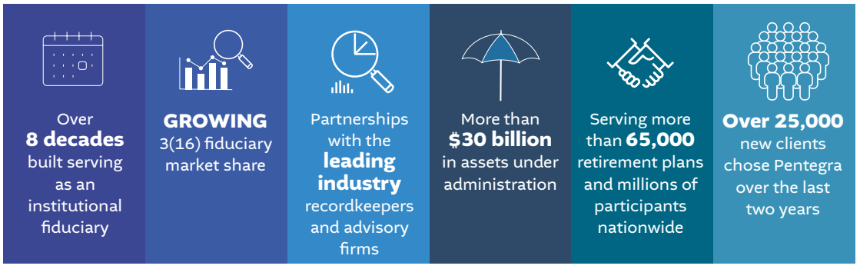
A Leading Fiduciary Expert with Partnerships Across the Industry
Today Pentegra is the partner of choice for ﬁduciary oversight across recordkeepers and advisors nationwide.
Pentegra’s ﬁduciary outsourcing services represent powerful tools for helping employers manage the legal responsibilities and risks that come with the decision to sponsor a retirement plan.

Slide 4



The Pentegra Consulting Advantage
A Focus on Improved
Plan Outcomes
The Bench Strength of a Highly Credentialed Team
We’ll Fix What Others Fear
Pentegra oﬀers a comprehensive
array of consulting services for every type of retirement plan. With a national footprint, clients and advisors partner with us to provide better retirement plans that run with less risk, more efficiency and improved outcomes.
We offer clients the bench strength of a tenured and professionally credentialed team. Our expert ERISA attorneys, ASPPA-certiﬁed consultants, actuaries, ﬁduciary and compliance specialists serve thousands of complex retirement plans nationwide and deliver among the highest level of expertise and technical support in the industry.
With our extensive experience as a ﬁduciary, we often identify issues with prior plan administration that need to be corrected for plans to remain compliant. We are skilled at ﬁnding plan issues before they become problems—collectively having saved clients hundreds of thousands of dollars in ﬁnes and penalties.

Slide 5



The Pentegra Consulting Advantage
A Strategic Approach to
Plan Design
We’re Comfortable Working
Outside the Box
CEFEX Certiﬁed
We oﬀer a consultative and strategic approach to plan design, taking into consideration peer analysis and competitive considerations to create a plan designed to maximize deferral opportunities, achieve beneﬁt and cost objectives and improved plan and participant outcomes.
We are agile when it comes to out-of-the-box features and practiced in plans that many aren’t willing to handle.
Pentegra is a Centre for Fiduciary Excellence (CEFEX) Certiﬁed Administrator, demonstrating our commitment to a standard of excellence and industry best practices.

Slide 6
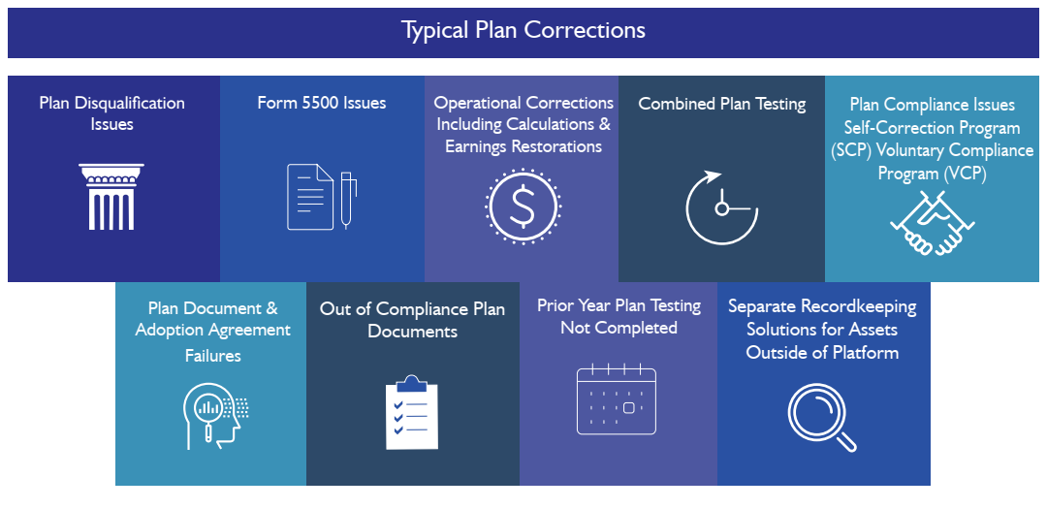
We Fix What Others Fear
As a ﬁduciary, we hold ourselves and the work we do to the highest standard. As part of our process, we regularly review plans and often identify issues with prior plan administration that need to be corrected for plans to remain compliant.

Slide 7
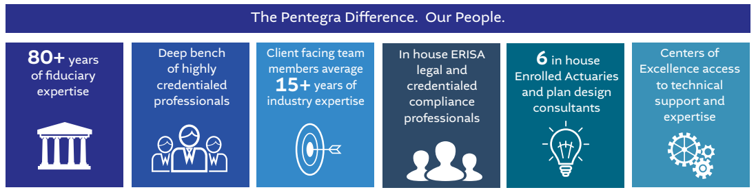
Deep Retirement Plan, Fiduciary and ERISA Expertise
With more than 300 associates, we offer comprehensive expertise across all plan types and complex plan designs.

Slide 8
Plan Correction Services
Failure to ﬁle 5500
Prepare 5500 and DFVCP for client to ﬁle
Combined Testing
Testing for Control Groups/Affiliated Service Groups and Dual Plan arrangements
Assets outside the platform that need a separate Recordkeeping Solution
Separate the outside assets for a 2 plan solutions, one plan with frozen assets and the other plan providing full retirement plan services through recordkeeper
Various Compliance Issues
Self Correction Program (SCP)
Voluntary Compliance Program (VCP)
Develop understanding of the issue, calculate impacts to plan participants and aid in preparation of appropriate documentation
Examples: Late contributions, incorrect proﬁt sharing allocations using wrong compensations, etc.
Adoption Agreement
Failures and Out of Compliance documents
Prepare new plan documents and ensure plan meets current regulation updates
Prior Year Plan Testing Not Completed
Collect required data and perform tests, addressing any failures through SCP/VCP

Slide 9

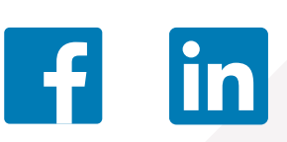
Pentegra. The Peace of Mind a Professional on Board Provides
Let’s talk about how Pentegra can help you.
Pentegra Retirement Services
855-549-6689
www.pentegra.com
316ﬁduciaryday.com
Follow our conversation

