Slide 1


The Pentegra 3(16) TPA Advantage
Name
Date

Slide 2






The Pentegra Difference
A Fiduciary First
Eight Decades of Expertise
An Independent Perspective
As a 402(a) Named Fiduciary, we hold ourselves to the highest standard of ERISA, for a higher level of care.
An 80+ year legacy serving as
an institutional ﬁduciary delivers an unmatched level of expertise.
As an independent ﬁduciary, we bring complete objectivity and impartiality to our work, resulting in greater plan governance and oversight.
A Higher Level of Responsibility
CEFEX Certiﬁed for a Higher
Standard of Care
Compliance Conﬁdence
As a ﬁduciary, we provide expert oversight and in-depth knowledge, shouldering much of the work and legal responsibility for managing a retirement plan.
Pentegra is one of an elite group of CEFEX certiﬁed Third Party Administrators, demonstrating a standard of excellence and industry best practices.
Clients enjoy the conﬁdence and peace of mind a professional on board provides.

Slide 3

The Pentegra TPA Difference
Pentegra offers a comprehensive array of Third Party Administrative (TPA) services for every type of retirement plan.
Our flexible arrangements can include an existing recordkeeper, trustee or investment manager.
Our clients hire us to provide better plans that run with less risk, more efficiency and improved outcomes.
Think of it as a better way to offer a retirement plan.

Slide 4
More Than a Traditional TPA
With 3(16) ﬁduciary outsourcing, you’ll have
more time to focus on what you do best.
As a 3(16) administrative fiduciary, Pentegra assumes key retirement plan responsibilities for you, transferring these responsibilities from your organization to ours. This helps you by not only eliminating work, but also minimizing your risk and responsibility for doing the work.

Slide 5

We Shoulder the Work and Take on the Responsibility
As a 3(16) administrative ﬁduciary, we are an extra set of eyes on your plan. We take care of the overall operation, and the administrative tasks associated with your plan. Clients have the assurance of knowing their plan is well designed, well managed and compliant.
Save time and reduce the responsibilities of ongoing maintenance and annual ﬁlings for your retirement plan.
Proactive monitoring by experts in 3(16) ﬁduciary administration who work seamlessly with your team.
Our services are layered on to your existing relationships with recordkeepers without disruption.

Slide 6

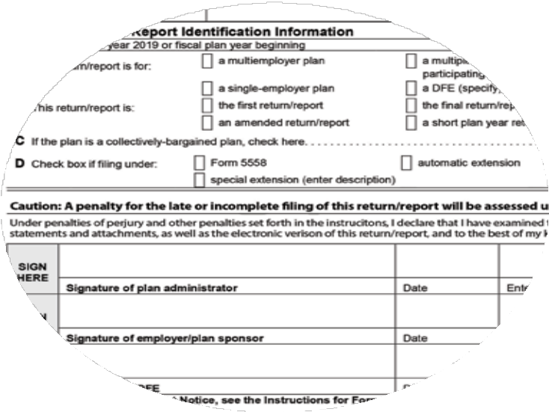
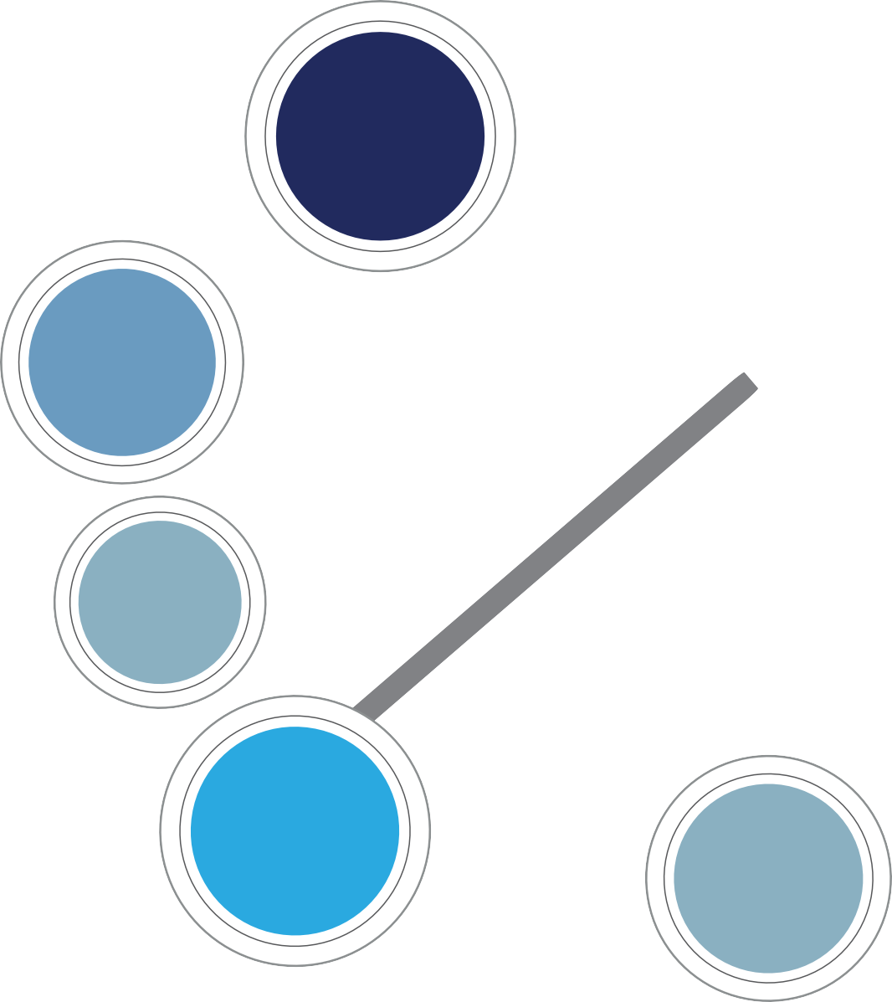

TPA 3(16)
Plan Operational Oversight and Compliance
Participant Notices, Statements and Disclosures
We take on all of this for you.
Forfeitures & Suspense Accounts
Contributions
Plan Document Administration
Pentegra
Government Filings
New Hire & Termination Processing
Plan Audit
As 3(16) Fiduciary Administrator, Pentegra assumes the risk and
responsibility of doing this work for you.
Claims & Benefit Determinations
Compliance Testing
Corrections
Hardship Distributions
Loans & Loan Repayments
Annual Plan Review Process
Participant Fee Disclosures
QDROs

Slide 7

Plan Responsibilities
Your Retirement Plan to Do List Today
Your Retirement Plan to Do List with Pentegra
Act as Named Plan Administrator
Take on Fiduciary Liability for Operating the Plan According to the Terms of the Plan
Selection & Monitor Service Provider(s)
Provide Timely, Complete & Accurate Payroll and Other Census Data
Make Timely Contributions
Sign and File Form 5500
Operational Compliance
Oversee Plan Document
Interpret Plan Provisions
Review Summary Plan Description (SPD) &
Summary Material Modiﬁcation (SMM)
Review Required Plan Amendments
Review Optional Plan Amendments
Review Participant Notices
Review Summary Annual Report (SAR)
Review and Approve/Deny Loan Requests
Review and Approve/Deny Home Loan Requests
Review and Approve/Deny Hardship Withdrawals
Review Distribution Requests
Review Qualiﬁed Domestic Relations Orders (QDROs)
Participant Fee Disclosure
Service Provider Fee Disclosure
Review Census Information
Review Compliance Testing
Verify Eligibility
Verify Vesting
Respond to Notices of Claims & Appeals
Review Force-outs
Manage Plan Audit
Provide Timely, Complete & Accurate Payroll and other Census Data
Make Timely Contributions
Select & Monitor Service Provider(s)

Slide 8
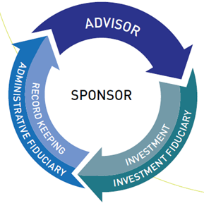
A Seamless Solution – 3(16) Overlay
Existing Relationships Stay Intact
We call this approach an overlay, because all existing trusted relationships stay intact, without any disruptions.
Our services are simply added on – or overlaid – seamlessly, and the sponsor receives independent monitoring of the plan.

Slide 9



Bringing Your Solution Together Seamlessly
Fully Bundled
Our bundled approach ‘bundles’ together plan administration, investment management and all other plan services, including plan design, consulting, recordkeeping, government filings and reporting, compliance, fiduciary responsibilities, communication and education.
Traditional TPA Services
We can also serve as a TPA with various platform partners, insurance companies, mutual fund families and financial institutions to provide independent administrative support in conjunction with trusted brand names in the retirement services industry.
Unbundled
We partner with firms as an independent resource to bring maximum flexibility to every opportunity on an unbundled basis. You and your client decide how you want to work with us and together we will select the services, fiduciary support, and investment platform that brings your solution together seamlessly.

Slide 10

TPA Services
PLAN DESIGN & DOCUMENT SUPPORT
PLAN DESIGN CONSULTING
PLAN CORRECTION CONSULTING
VOLUNTARY COMPLIANCE SUBMISSIONS (VCP)
GOVERNMENT FILINGS
TAX REPORTING
COMPLIANCE SUPPORT
LEGAL SUPPORT
PLAN NOTICES
LEGISLATIVE & REGULATORY UPDATES
PLAN ADMINISTRATION
CENSUS DATA & REPORTING
PLAN ELIGIBILITY & CONTRIBUTION REVIEW
ANNUAL PLAN VALUATIONS
ANNUAL PLAN CALCULATIONS

Slide 11
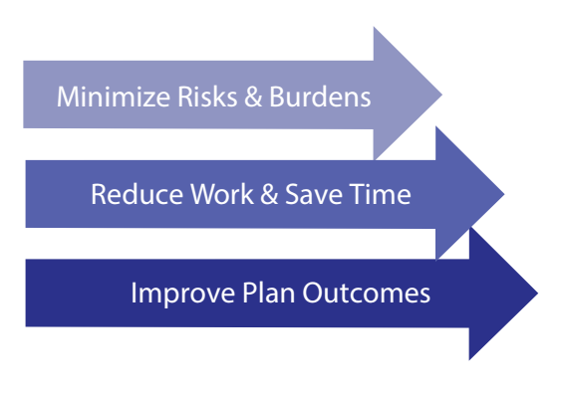
A Better Way to Offer a Retirement Plan

Slide 12

Achieve Improved Plan and Participant Outcomes
For Your Business
For Your Plan
For Your Participants
Shift the ERISA 402(a) ﬁduciary risk and responsibility you assume as plan sponsor to an actual ﬁduciary expert.
Achieve organizational cost and beneﬁt objectives with a consultative approach to plan design aligned with ﬁduciary best practices.
Build a competitive advantage with a comprehensive, high-quality retirement plan.
Maximize tax-efficient strategies
for business owners and key
employees.
Deliver compliance conﬁdence by ensuring your plan is current with changing legislative and regulatory developments.
Minimize risk and liabilities associated with plan ﬁduciary obligations.
Prevent plan errors with ﬁduciary oversight and management of plan processes.
Reduce administrative burdens by outsourcing time-consuming
plan tasks.
Increase participant satisfaction through our partnership with your plan recordkeeper to help deliver an optimal retirement experience and improved plan metrics.
Streamline participant events such as loans, hardships, in-service withdrawals, and distributions.
Improve plan outcomes with a best-in-class approach to offering a retirement plan.

Slide 13

Why Pentegra?
Why Pentegra?
Pentegra is one of America’s oldest, most experienced independent institutional ﬁduciaries. In fact, we were built to be a ﬁduciary.
We’re CEFEX Certified.
Pentegra is a Centre for Fiduciary Excellence (CEFEX) Certified Administrator, demonstrating our commitment to a standard of excellence and best practices and a culture of good governance and oversight. Pentegra is part of an elite group of firms in the nation that has successfully completed the independent certification process for TPA service providers.

Slide 14

Let’s Get Started!
Expect a call within the next couple of weeks from your Pentegra Regional Director.
Compare FA names and opportunities you are working on.
Request Fee Proposals, Marketing Material, and Service Agreements.
Ask them about our Marketing Cloud, get a Digital Conversations demo, and ask them about anything you need.

Slide 15

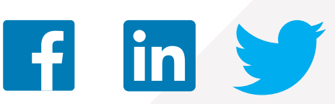
Contact Us
Let’s talk about how Pentegra can help you
Contact a Pentegra representative today
Pentegra Retirement Services
855-549-6689
www.pentegra.com
http://316fiduciaryday.com/

